Slide 1


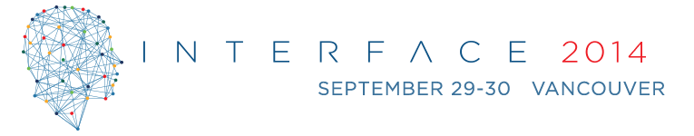
  Privacy in the Era of Big Data
  Dr. Paul Terry
  President & CEO
  pterry@phemi.com

Slide 2
Concepts
Big Data : Volume, Variety, Velocity
Compute : Storage
Statistics : Machine Learning
Observations : Transactions
Information in Context
Sense – Making
Write data, Compute Everything
Privacy
Security

Slide 3
Security vs Privacy
Privacy discourse involves difficult normative decisions about competing claims to legitimate access to, use of, and alteration of information. It is about selecting among different philosophies, and choosing how various rights and entitlements ought to be ordered.
Security implements those choices – it intermediates between information and privacy selections.
Derek E. Bambauer: Privacy vs Security
University of Arizona - James E. Rogers College of Law
January 29, 2013

Slide 4
Privacy
Privacy is about :
Legitimate Claims to (Access - Use - Modify) Information
Legitimate Claim = f (Rights, Entitlements)
Hence: technical, business, legal, policy and Identity matter.
Note that Information != Data

Slide 5
Security
Security is not Privacy
When considering security think of:
A door lock, a burglar alarm and a tall fence. Think of guns, anti-counterfeiting measures on currency and that dumb liquid ban at airports.
Security affects privacy only when it's based on identity

Slide 6
Security / Privacy
Security is vital to survival
Privacy is a human (social) need (unique to humans)
Identity theft threatens security through a breach in privacy

Slide 7
HIPAA Definitions
Privacy vs. Security
HIPAA regulations cover both security and privacy. Security and privacy are distinct, but related.
The Privacy rule focuses on the right of an individual to control the use of his or her personal information. Protected health information (PHI) should not be divulged or used by others against their wishes. The Privacy rule covers the confidentiality of PHI in all formats including electronic, paper and oral. Confidentiality is an assurance that the information will be safeguarded from unauthorized disclosure. The physical security of PHI in all formats is an element of the Privacy rule. See Guidelines for Physical Security: Paper Medical Records and PHI in All Formats.
The Security rule focuses on administrative, technical and physical safeguards specifically as they relate to electronic PHI (ePHI). Protection of ePHI data from unauthorized access, whether external or internal, stored or in transit, is all part of the security rule.

Slide 8

Privacy by Design – Center of Excellence
Location: Ontario Canada

Slide 9
Gold Standard
Privacy by Design is fast becoming the ‘Gold Standard’ for Privacy.
For example, the US Federal Trade Commission has placed it at the center of its security and privacy protection.
We have a world where mobile, e-commerce,
e-services, Machine2Machine and Cloud are the norm not the exception.

Slide 10
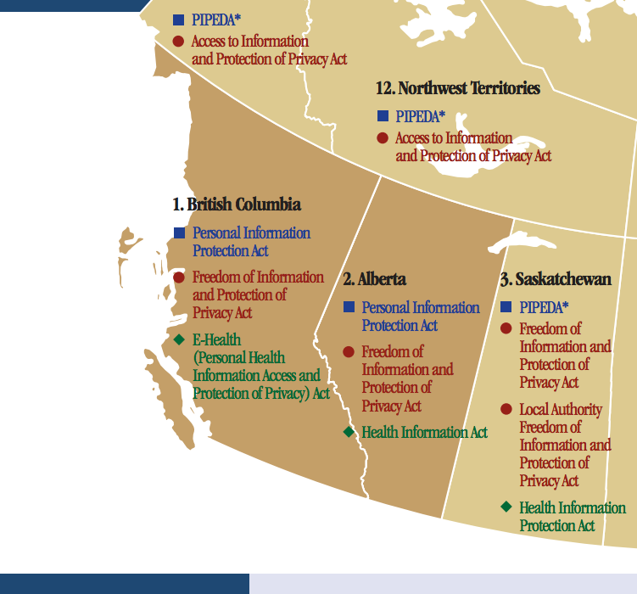
Canadian Privacy Laws

Slide 11
Privacy by Design
Privacy by Design is a framework that was developed by the Information and Privacy Commissioner of Ontario, Canada, Dr. Ann Cavoukian. Privacy by Design advances the view that the future of privacy cannot be assured solely by compliance with legislation and regulatory frameworks; rather, privacy assurance must become an organization’s default mode of operation.
The objectives of Privacy by Design — ensuring privacy and gaining personal control over one’s information and, for organizations, gaining a sustainable competitive advantage
In October 2010, Privacy by Design was recognized as the global privacy standard in a landmark resolution by the International Conference of Data Protection and Privacy Commissioners in Jerusalem. Since then, the 7 Foundational Principles of PbD has been translated into 30 official languages.

Slide 12
Privacy by Design
PbD prescribes that privacy be built directly into the design and operation, not only of technology, but also how a system is operationalized (e.g., work processes, management structures, physical spaces and networked infrastructure.)
PbD is widely recognized internationally as the standard for developing privacy compliant information systems.
As a framework for effective privacy protection, PbD’s focus is more about encouraging organizations to both drive and demonstrate their commitment to privacy than some strict technical compliance definition.

Slide 13
7 Business Foundation Principles
Proactive not Reactive; Preventative not Remedial
Privacy as the Default Setting
Privacy Embedded into Design
Full Functionality – Positive Sum not Zero Sum
End to End Security – Full Lifecycle Protection
Visibility and Transparency – Keep it Open
Respect for User Privacy – Keep it User-Centric

Slide 14
Enterprise Amnesia
Definition :
The inability of an organization to benefit from the information it has access to or has generated in the past.

Slide 15
Sense Making Systems
“Sensemaking” relates to an emerging class of technology designed to help organizations make better sense of their diverse observational space. This observation space will often encompass data they have in their possession and control (e.g., structured master data), as well as data they cannot control (e.g., externally-generated and less structured social media).
From a sensemaking point of view, an organization can only be as smart as the sum of its observations.

Slide 16
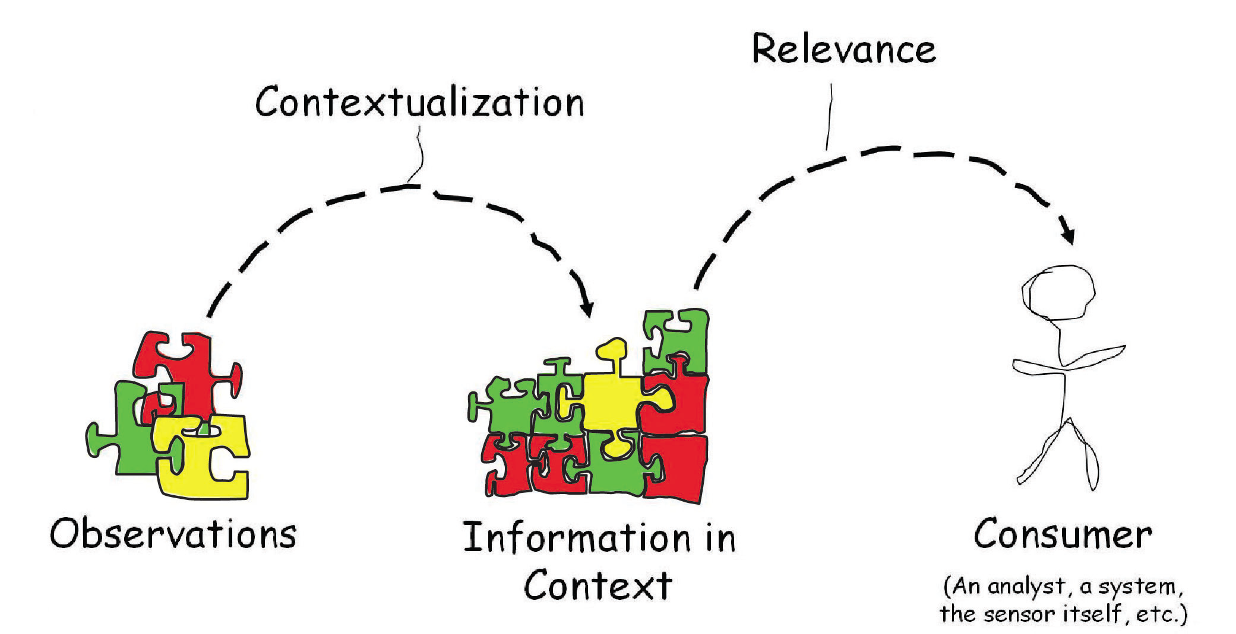
Sensemaking Systems
Context Accumulating Systems
Source: Privacy by Design in the Age of Big Data
Reduces false positives/negatives
Errors in the data are helpful – detects plausible variations
Integrating transactions becomes more accurate and (strangely) faster
Privacy/Security becomes harder as data/information becomes more valuable

Slide 17
PHEMI
Dr. Paul Terry
pterry@phemi.com
www.phemi.com

